Slide 1


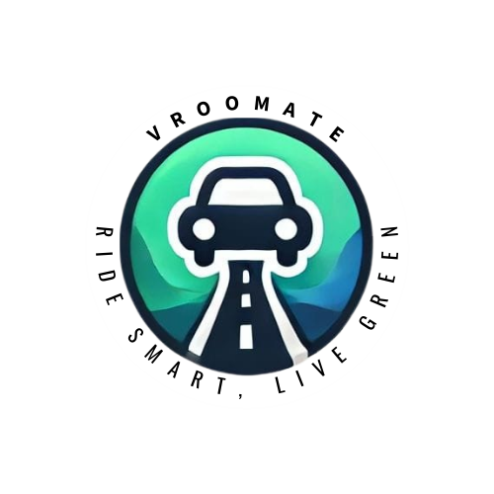
VROOMATE
Ride Smart, Live Green
Theme: Sustainable Development For Better Future

Slide 2
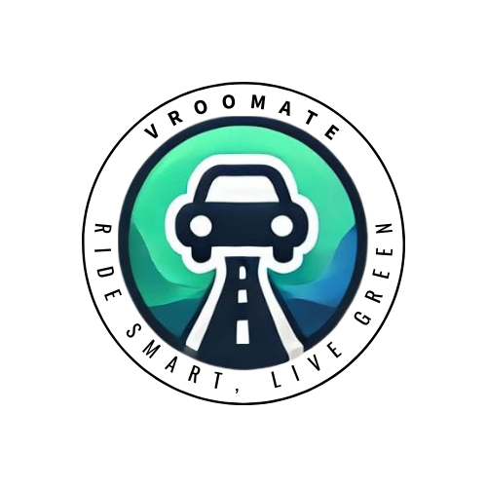

Slide 3

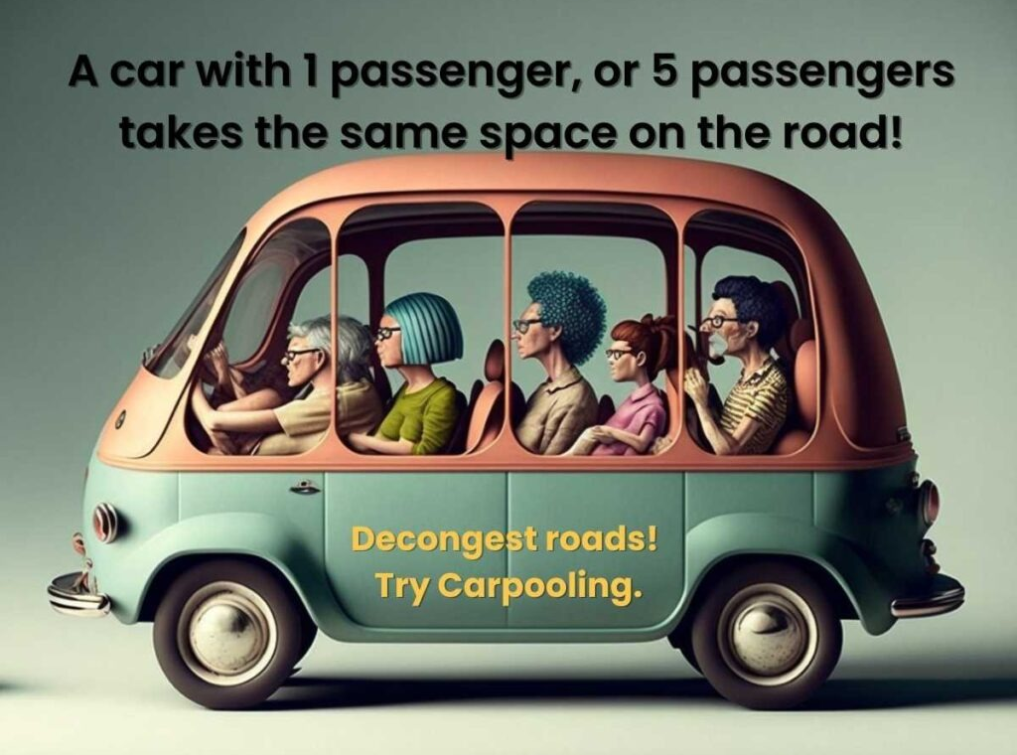
Problem Statement
Many people commute to work, school, or other destinations daily, often using personal vehicles. This leads to-
Traffic congestion:
Increased Traffic
Longer Commute Times
Environmental impact:
Higher Fuel Consumption
Increased Carbon Emission
High transportation costs:
Fuel Expenses
Vehicle Maintenance

Slide 4
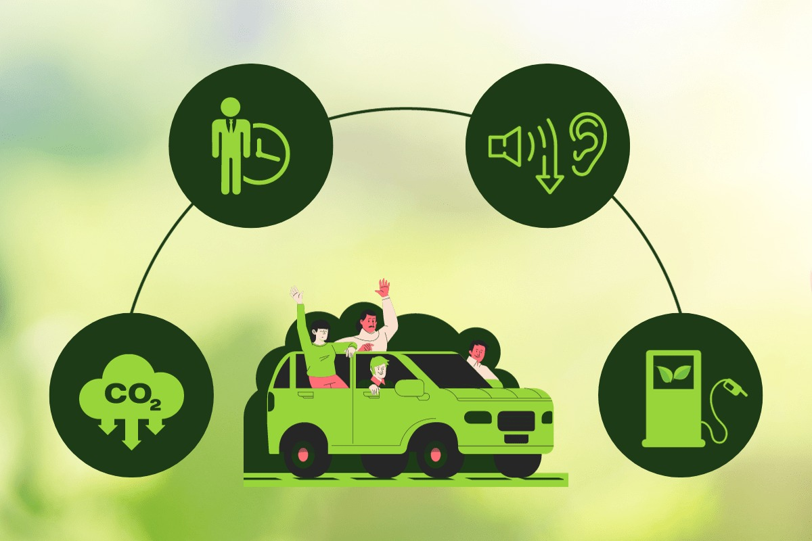
Proposed Solution
A carpooling app that efficiently connects people with compatible travel routes, providing a convenient and sustainable transportation solution.
Benefits-
Reduced Traffic Congestion
Environmental Impact Reduction
Cost Saving
Social Interaction
Convenience

Slide 5
KEY FEATURES:
Route Matching:
Matching users with similar routes, minimizing detours and maximizing efficiency.
Real-time Communication:
In-app messaging and chat features for easy communication between drivers and riders.
Payment Integration:
Secure and convenient payment options for riders to contribute to fuel costs.
Ratings and Reviews:
System to encourage trust and accountability among users.
Safety Features:
Emergency contact information, location sharing, and user identification using Aadhaar and other government authorized documents

Slide 6
TARGET MARKET:
Commuters:
Individuals who regularly travel to work, school, or other destinations.
Students:
Students who need transportation to and from campus.
Employees:
Employees who commute to work and are interested in sharing rides with colleagues.
Residents of urban areas:
People living in cities with high traffic congestion and limited public transportation options.
Inter-City/State travelers:
People traveling long distances by road for cost effective travel.

Slide 7
MONETIZATION STRATEGY:
Transaction Fees:
A small fee charged by the app for each ride completed.
Premium Membership:
Offer additional features and benefits to premium subscribers.
Partnerships:
Collaborate with businesses and organizations to offer discounts or promotions.

Slide 8
SCALABILITY
Regional Expansion Strategy:
Start with major cities that have high traffic or commuting issues, and expand gradually to smaller cities and towns.
Customize services for each city (local ride-sharing preferences, peak hours, etc.) based on user feedback.
Partner with local governments or organizations to promote the service in new regions.
Strategic Partnerships:
Partner with ride-hailing services, cab aggregators, or local transportation authorities to integrate Vroomate into existing transportation networks.
Collaborate with petrol stations, car service centers, or EV charging stations to offer perks for Vroomate drivers.

Slide 9
How is our solution unique from others in the market?
Advance Ride Booking:
Vroomate allows users to book shared rides well in advance, offering flexibility for planning trips. This reduces last-minute stress and ensures better ride availability.
Sustainability Focus:
The app is designed with the theme of "Sustainable Development for a Better Future," actively contributing to reducing traffic congestion and carbon emissions, aligning with global environmental goals
Pre-Scheduled Rides for Recurring Trips:
For daily commuters, Vroomate supports recurring ride bookings (e.g., home to office), allowing users to set up daily or weekly schedules, saving time and providing consistent travel options.
Corporate and Institutional Partnerships:
Vroomate partners with companies and universities to provide tailored carpooling services for employees and students, reducing parking issues and promoting eco-conscious commuting.

Slide 10
Roadmap
- Phase 1: Research & Planning
Analyze existing solutions and user needs
Define core features (ride-sharing, ride-posting, seat availability, user verification etc.)
Finalize technology stack
- Phase 2: App Development
Front-end design for a user-friendly interface
Back-end development for real-time ride matching and database integration
Implement features like driver input, ride tracking, and notifications
- Phase 3: Testing & Refinement
Conduct beta testing to gather user feedback
Fix bugs, enhance user experience, and ensure security
- Phase 4: Launch & User Acquisition
Launch app on app stores
Focus on marketing and partnerships for user growth
- Phase 5: Continuous Improvement
Roll out updates based on user feedback
payment options and route optimization
Introduce new features with time

Slide 11
Technology Stacks
Frontend – Java SWING
Backend - JAVA
mySQL Database
Google Maps API (additional feature, not added yet)

Slide 12

Thank You

